Slide 1
WEB TECHNOLOGY

Slide 2
UNIT 3
WEB SERVICES

Slide 3
The evolution of the internet and its exponential growth in recent years has led to the development of complex applications that are managed across different platforms and geographical boundaries.
These applications may consist of components that may have been developed using different programming languages and hosted in application involves ensuring that such components are interoperable.

Slide 4
A Web service exposes a number of methods to provide functions that can be used by one or more applications, regardless of the programming languages, operating systems, and hardware platforms used to develop them.
The methods that provide such function are called Web methods.

Slide 5
The functions used by a Web service can be accessed by applications using Internet standards, such as Simple Object Access Protocol (SOAP).
SOAP is a protocol that uses eXtensible Markup Language (XML) to describe data and HyperText Transfer Protocol (HTTP) to transmit application data.
An application that uses a Web service is called a Web service client.

Slide 6
Web services provide the following benefits:
Easy accessibility:
Any computer that has access to the Internet can easily access a Web service.
This enables a number of applications residing on different software and hardware platforms to exchange data between each other.

Slide 7
Web services provide the following benefits:
Flexibility in structure:
Depending on the requirements of a business, different types of Web services can be created and used in an application.
For example, you can create simple Web services that provide a fundamental functionality that can be used in multiple applications. You can also create Web service to integrate the existing applications that might have been created using different software and hardware platforms.
Web services also prove useful in business-to-business transactions.
Business partners may have applications running on different platforms.
These applications can exchange data by using Web services.

Slide 8
Web services provide the following benefits:
Easy Integration:
Using Web services, you can easily integrate business applications developed on different software and hardware platforms resulting in low setup costs.
In addition, you can integrate Web applications with applications such as spreadsheets or back-end database to provide online information.

Slide 9
A Web service has the following elements:
XML(extensible markup-language)
SOAP(simple object access protocol)
WSDL(web services description language)
UDDI(universal description discovery and integration)

Slide 10
A Web service has the following elements:
XML:
XML is used to exchange data over the Internet.
To enable data interchange, you require a standard data representation format that can be understood by any platform. Because XML is a plain-text format that can be understood by any type of hardware device over the Web, it is able to fulfill this requirement.

Slide 11
SOAP:
To be able to communicate with each other, a Web service and a client application must agree upon a common protocol.
SOAP is a standard communication protocol for interchanging information in a structured format in a distributed environment.
The information exchanged between the client application and the Web service is called a message.

Slide 12
WSDL
To be able to use a Web service, the developers of a client application need to know the methods exposed by the Web service and the parameters to be passed to these methods.
WSDL is a markup language that describes a Web service

Slide 13
UDDI(universal description discovery and integration)
It provides a standard mechanism to register and discover a Web service.

Slide 14
Managing States of an ASP.NET Application
State is quite an innovative concept in Web development.
It is an innovative concept because it eliminates the drawback of losing state data on page-reload.
By using states with your Web application, you can preserve the state of a Web application both at the server or client end,
The state of a Web application actually stores the changes that have been made to the Web application.
If you are not using states then these changes get discarded.
For example an e-commerce shopping site or an internet site of a company to keep track of the user requests, such as the items chosen by the user on a shopping site.

Slide 15
Various means of storing state information:
HiddenField control:
The HiddenField control is not visible when the application is viewed in the browser;
This control acts as a storage area for storing any page specific information.

Slide 16
Cookies:
These are the text files that store data, such as user ID and preferences at the client end;
when a browser again requests the same web page, the cookie is sent along with the request; the Web server then retrieves the information from the cookie.

Slide 17
Query Strings:
These are the information strings added at the end of a URL to mention the state of a Web application;
however, the use of query string is not secure because the query string values are exposed to the internet through the URL.

Slide 18
An application can have three types of states:
application state,
session state
view state

Slide 19
Application-State
The application-state is used to store the data corresponding to the global variables of an ASP.NET Web application.
The data in the application-state is stored once and read many times.
The application-state uses the HttpApplicationstate class to store and share the data throughout the application.
You can access the information stored in the application-state by using the HttpApplication class property.
The HttpApplicastionstate class provides a lock method that you can use to ensure that the only a single user access and modify data of an ASP.NET Web application at any instant of time.

Slide 20
Session-State
Each client accessing a Web application maintains distinct session with a Web server.
There is also specific information associated with each of these sessions. Session-state is used to store this information.
The session-state is defined in the <sessionState> section of the web.config file and stores the data specific to a user session in session variables.
Different session variables are created for each user session. Also, the session variables can be accessed from any page of a Web application.
When a user accesses a web page a session ID for the user is created.
The session ID is transferred between the server and the client over the HTTP protocol using cookies.

Slide 21
view-state
The view-state stores the page-specific information when a page is posted back to the server.
When a page is processed, the current state of the web page and control is hashed into a string and saved as a hidden field. Such a state of web page is called view-state and is defined as a hidden field on a web page.

Slide 22
The ViewState property is used to save the view-state for each control, such as HTML controls and Web controls used in a web page.
If the ViewState property is not used, then the values written in various controls, such as Textbox and Checkbox on the web page are not retained when the page is reloaded.

Slide 23
Enabling Technologies Used in Web Services
A Web service can be created using any programming language in the .NET suite, s Visual Basic .NET
Visual C#.NET
C++.NET.
some requirements need to be fulfilled to enable applications to access the functionality provided by Web services.

Slide 24
These requirements are listed below:
• A common data representation format in order to ensure the interoperability of the data exchanged by the client application and the Web service.
• A standard method for sending messages from the client application to the Web service and vice versa.
• A standard format for describing the Web service.
• A mechanism to allow client applications to discover the Web services and their location

Slide 25
To cater to these requirements, various standards such as
eXtensible Markup Language(XML)
Simple Object Access Protocol(SOAP),
Web Services Description Language(WSDL).
Universal Description Discovery and Integration(UDDI)

Slide 26
XML
A client application passes arguments to a method exposed by a Web services. The method performs some action on the arguments and returns the results to the client application.
The data returned by the Web service can be used by the client application, regardless of the hardware and software platform used to develop the application.
To enable this kind of data interchange, you require a standard data representation format that can be understood by any platform.
Since XML is a plain-text format that can be understood by any kind of device, it caters to this requirement.

Slide 27
SOAP
To be able to communicate with each other, a Web service and a client application must agree upon a common protocol.
SOAP is a standard communication protocol for interchanging information in a structured format in a distributed environment.
The information exchanged between the client application and the Web service is called a message.

Slide 28
Messages include the calls made by the client application to a web method and the data returned by the Web method to be client.
When a client application makes a request for a Web method, a SOAP packet is created.
This packet contains the name of the Web method to be invoked and the parameters to be passed to the Web method in an XML format.
This information is used to invoke the Web method with the appropriate parameters.

Slide 29
When the SOAP packet arrives at the Web server on which the Web service resides, the Web method name and its parameter are extracted from the SOAP packet and the appropriate Web method is invoked.

Slide 30
WSDL
To be able to use a Web service, the developers of a client application need to know the methods exposed by the Web service and the parameters to be passed to these methods. Therefore, you need a standard method to describe the methods that are exposed by a Web service.
This information should be readily accessible to the Web service clients during the design phase. This is achieved by using Web Services Description Language(WSDL).
WSDL is a markup language that describes a Web service.

Slide 31
A WSDL document contains the following information about a Web service:
The Web service available for a given Web site
The purpose for which these service can be used
The types of parameters that need to be passed to a Web service
The types of value that is returned by a Web service
The format used to access these Web services
The URL at which a We service can be accessed

Slide 32
UDDI provides a standard mechanism to register and discover a Web service.
When a Web service provider wants to make a Web service available to client applications, the provider describes the Web service by using a WSDL document.
The provider registers the Web service in the UDDI Directory.
The UDDI Directory contains pointers to the web service and the WSDL document for the Web service.
Client application can then discover the Web service by using the UDDI Directory.

Slide 33
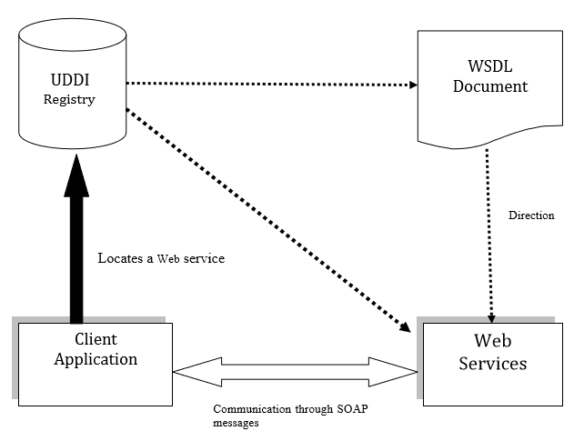
The following diagram depicts the relation between the various enabling Web service technologies

